Slide 1
Chapter 1: Introduction
examples of fields that use digital image processing

Slide 2
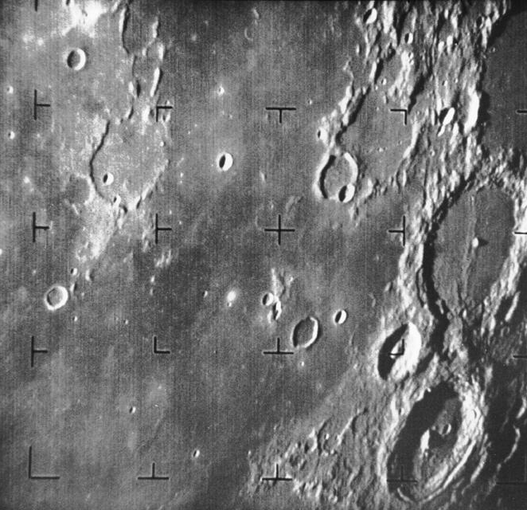
What Is Digital Image Processing?
A sample digital image. 662*640*256.
y
x

Slide 3
f(x,y): A two-dimensional function, where x and y are spatial coordinates, and the amplitude of f at any pair of coordinates (x,y) is called the intensity or gray level of the image at that point.
x size: 662, y size: 640, gray levels: 256
Digital image: x, y, and the amplitude values of f are all finite, discrete quantities

Slide 4

A sample color digital image, 800*600*24 bits

Slide 5

Pixel: The elements of a digital image.
Pixels

Slide 6
Some applications
FUJIFILM: Searching faces, Fuji.htm
License plates, Licence.htm
Tracking people, Hand.htm

Slide 7
The Origins of Digital Image Processing
One of the first applications of digital images was in the newspaper industry, when pictures were first sent by submarine cable between London and New York.

Slide 8
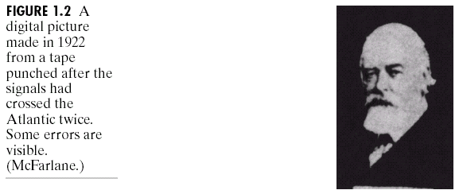
Better quality

Slide 9
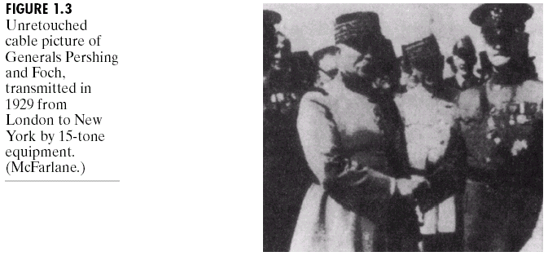
15-tone equipment

Slide 10
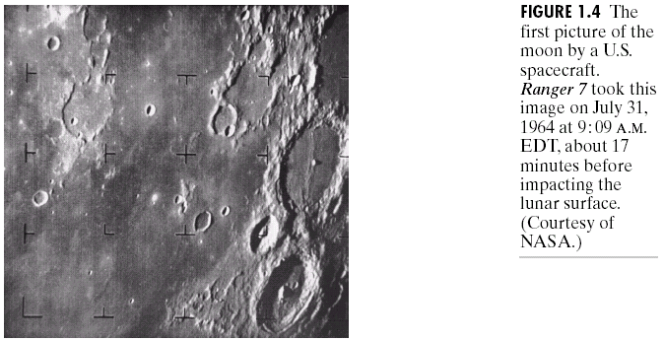
From computers, meaningful image processing tasks appeared.

Slide 11
Image is every where
Medical imaging
Remote Earth resource observations
Astronomy
High-energy plasmas and electron microscopy

Slide 12
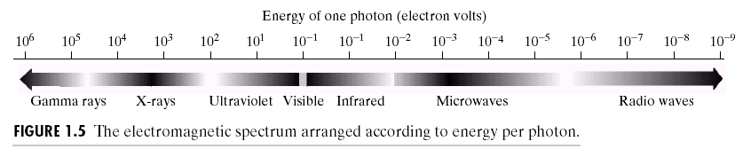
Examples of Fields tat Use Digital Image Processing
Electromagnetic energy spectrum

Slide 13
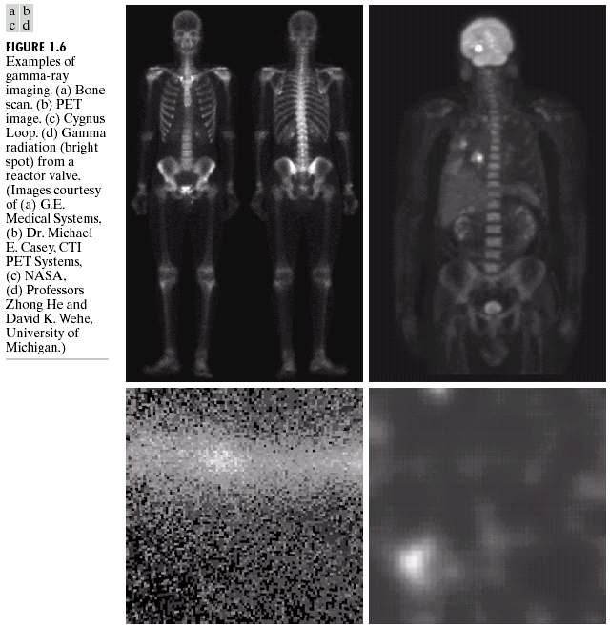
Gamma-Ray Imaging

Slide 14
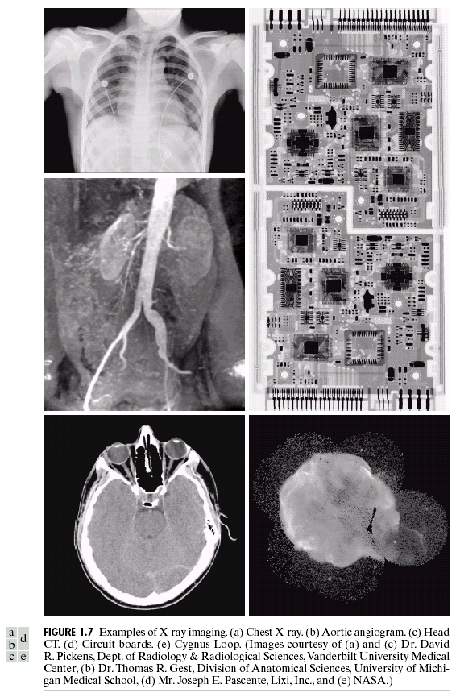
X-ray Imaging

Slide 15
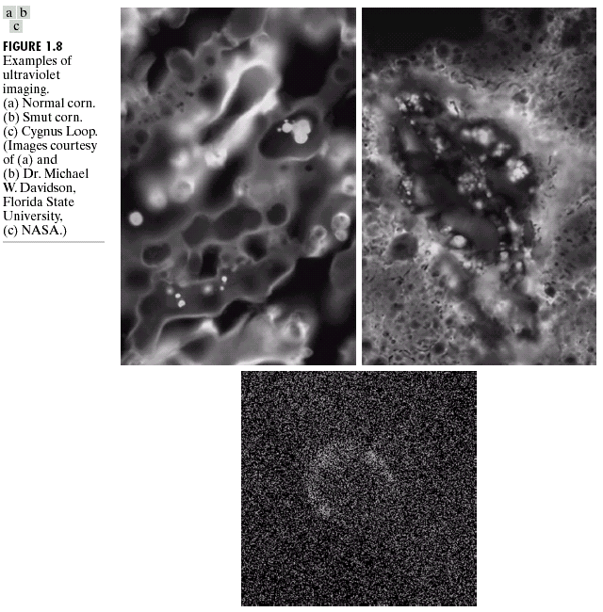
Imaging in the Ultraviolet Band

Slide 16
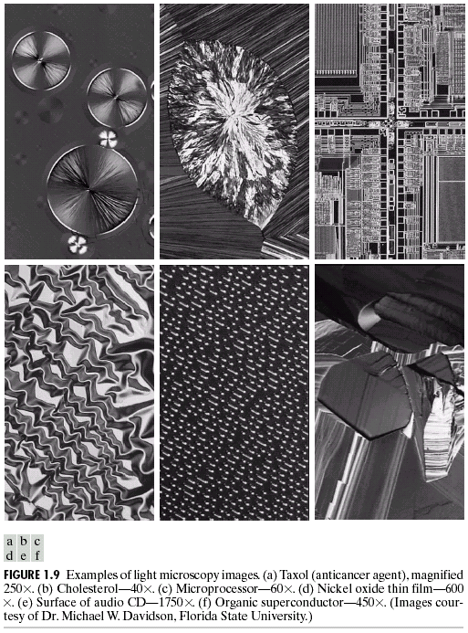
Imaging in the Visible and Infrared Bands

Slide 17
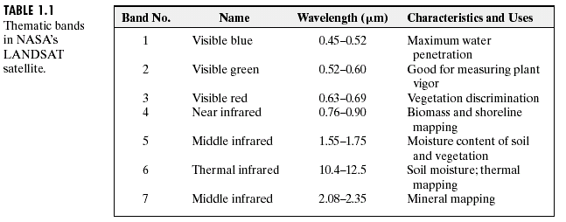
Remote sensing

Slide 18
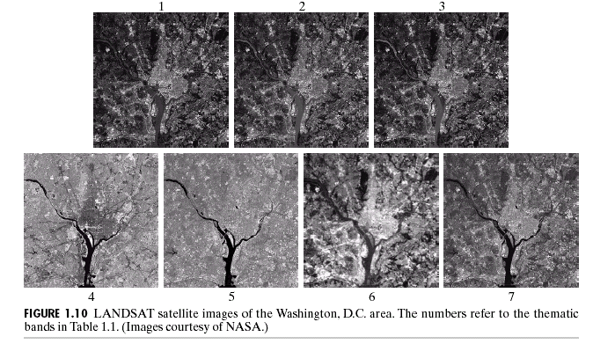

Slide 19
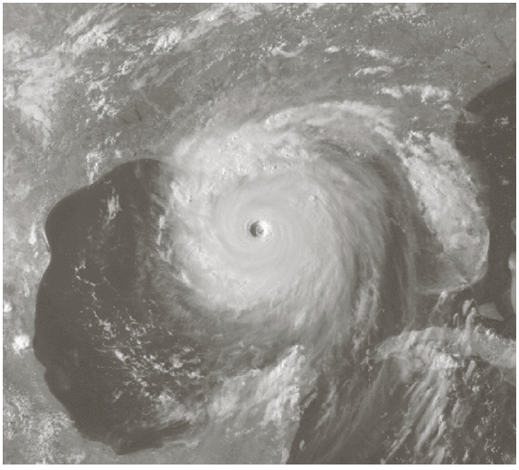
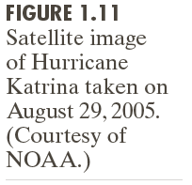
Weather Observation, visible and infrared bands

Slide 20
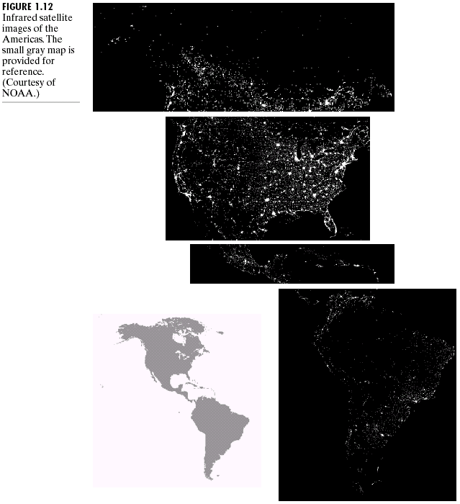
Infrared imaging

Slide 21
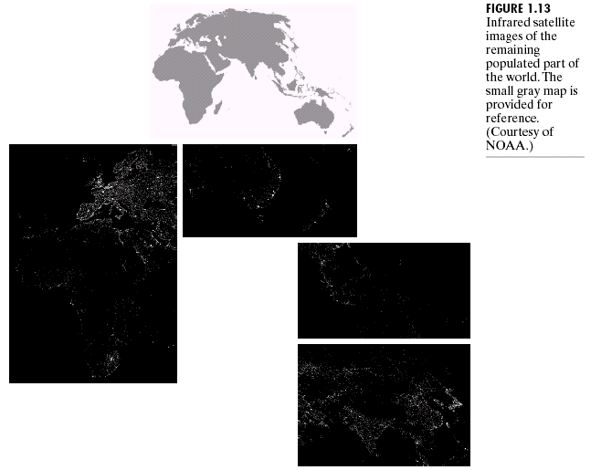

Slide 22
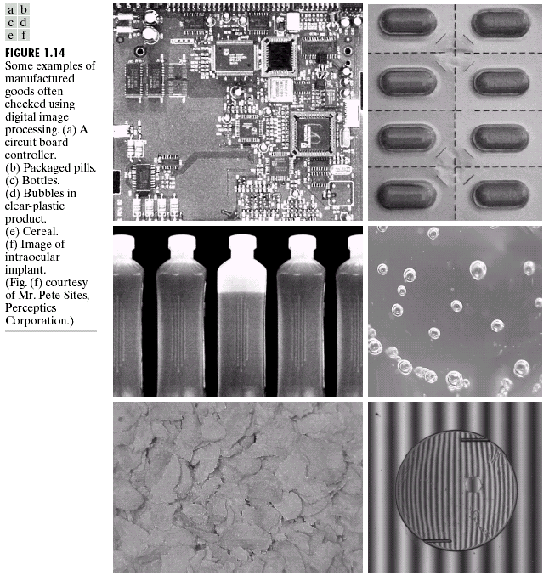
Automated visual inspection

Slide 23
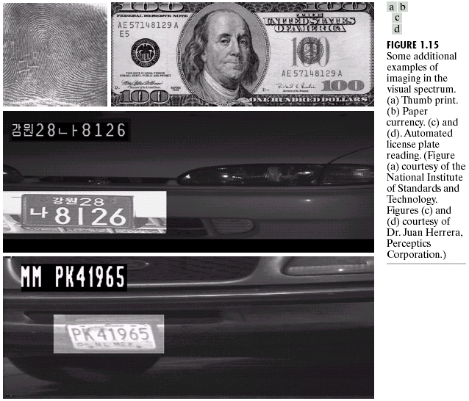

Slide 24
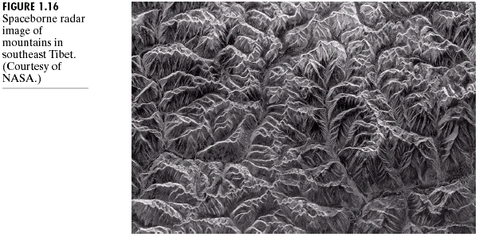
Imaging in the Microwave Band

Slide 25
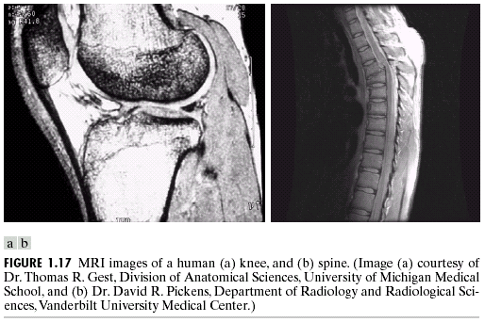
Imaging in the Radio Band
MRI

Slide 26
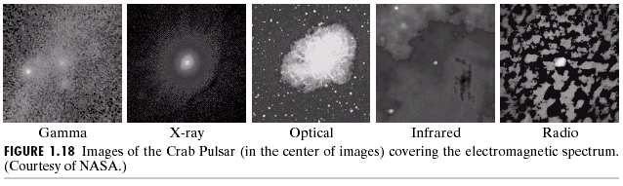

Slide 27
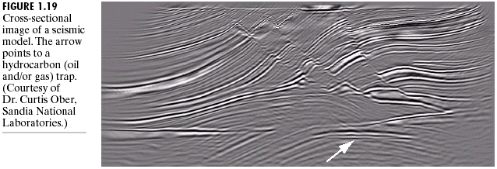
Examples in which Other Imaging Modalities Are Used
Sound

Slide 28
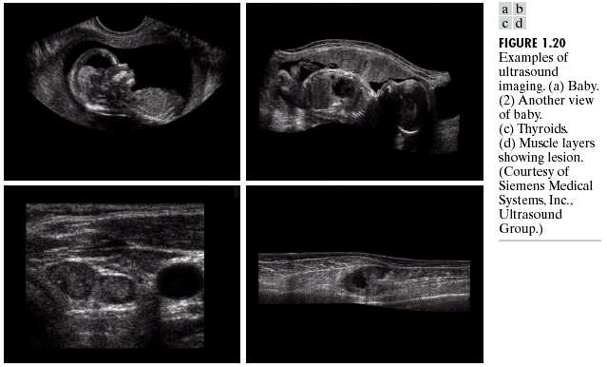
Ultrasound

Slide 29
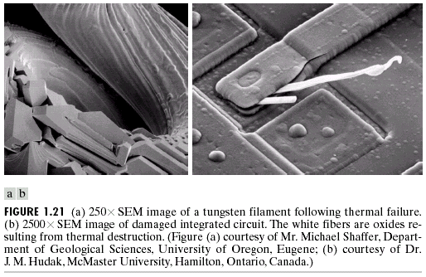
Electron Microscope

Slide 30
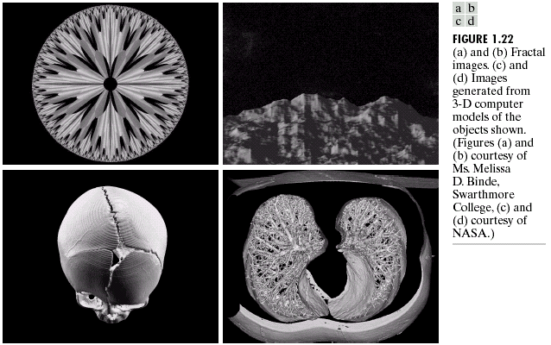
Images generated by computers

